Slide 1
Blood groups and blood types

Slide 2
Purpose of blood typing
Blood transfusion is a life-saving procedure in all cases of severe loss of blood, and in life-threatening anemia.
However, blood can only be given after blood grouping which is an essential requirement before blood is given to any individual

Slide 3
PRINCIPLE
A blood type (also called a blood group) is a classification of blood based on the presence or absence of inherited antigenic substances on the surface of red blood cells (RBCs).
Blood is characterized into different blood groups, based on the presence or absence of these antigens or agglutinogens.
The ABO blood group is characterized by two glycolipid antigens, called A and B – depending on whether the RBCs have none, only one or both antigens, blood groups are distinguished as type O, type A, type B, or type AB.

Slide 4
Agglutinins of ABO System
Blood plasma contains antibodies or agglutinins that react with non-self antigens.
They are absent in a newborn; the ABO antibodies start appearing in the plasma by the age of 3–4 months due to cross reactivity of ABO antigens present in naturally occurring bacteria, viruses, pollen, etc. present in the environment.
These antigens are absorbed into blood and stimulate the formation of antibodies against antigens not present in the infants’ red cells, i.e. those antigens that are recognized as “non-self” by the body’s immune system.
Because the resulting antibodies are large IgM-type molecules that cannot cross the placenta, incompatibility between mother and foetus is not a common problem.

Slide 5
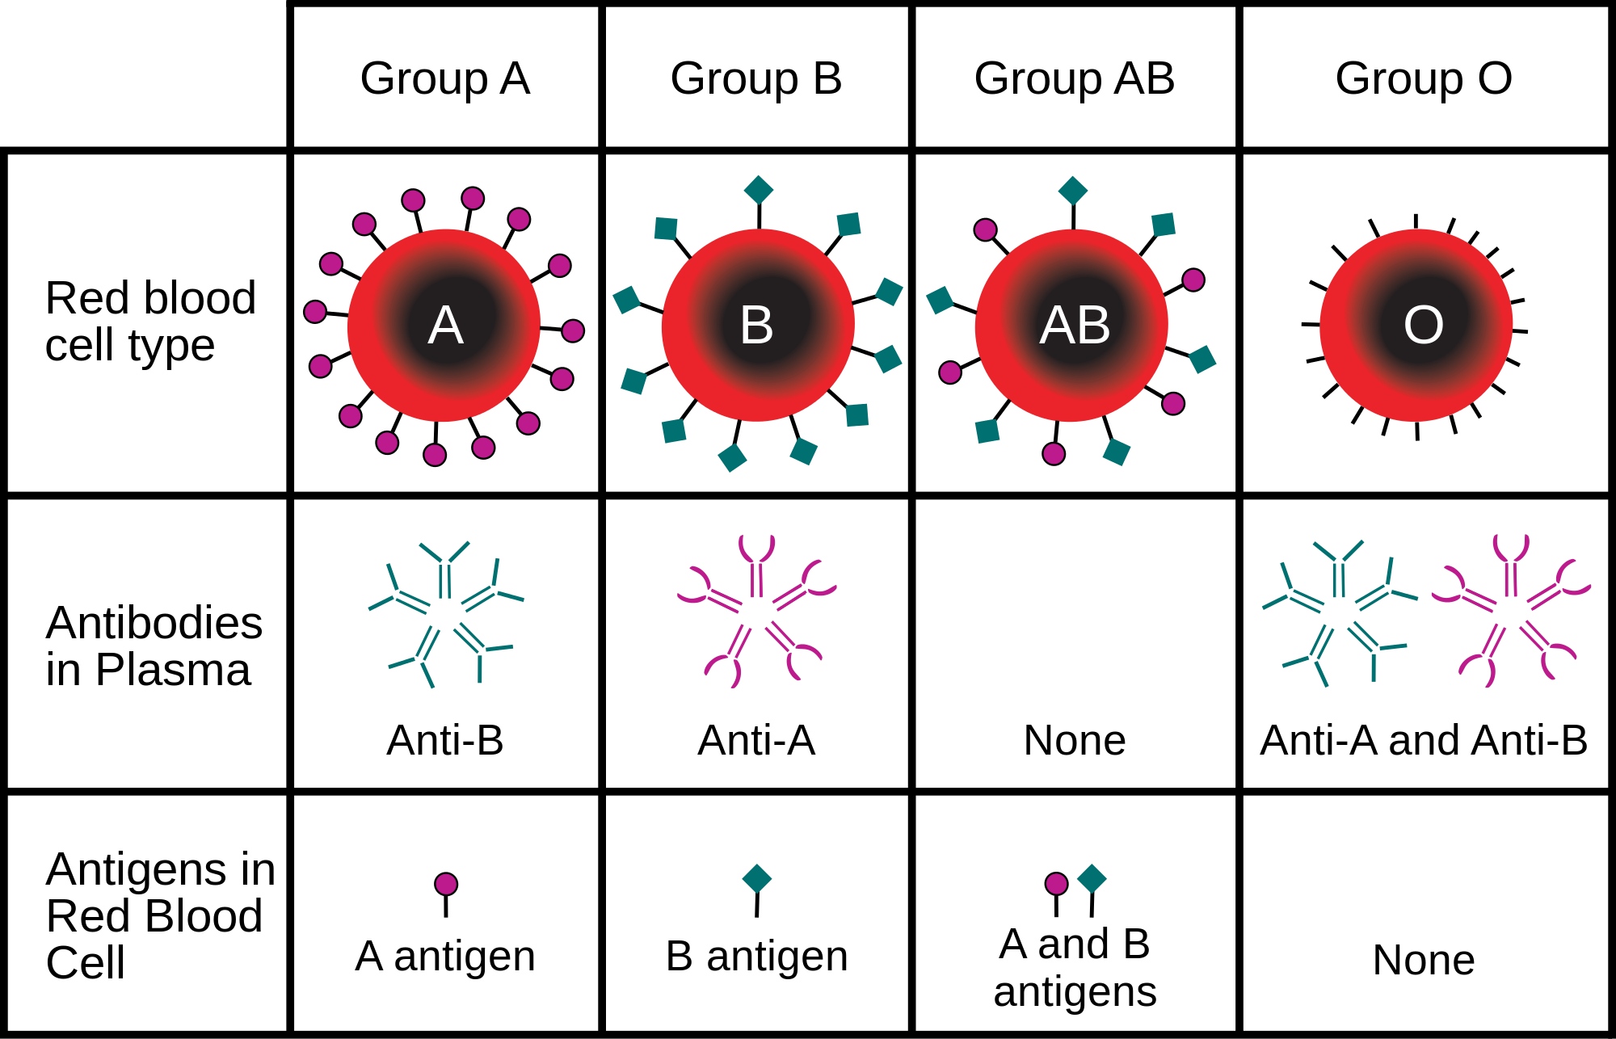

Slide 6
Agglutination
If someone receives blood of the wrong type, the worst problem is the reaction of the recipient's antibodies on the donor's RBCs.
When the body encounters a foreign antigen, agglutination occurs.
Agglutination is the clumping of RBCs due to binding of antibodies (part of the immune system) to antigen, and causes blockage of blood vessels and eventually death.

Slide 7
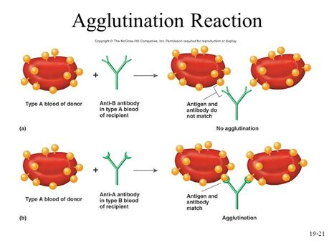

Slide 8
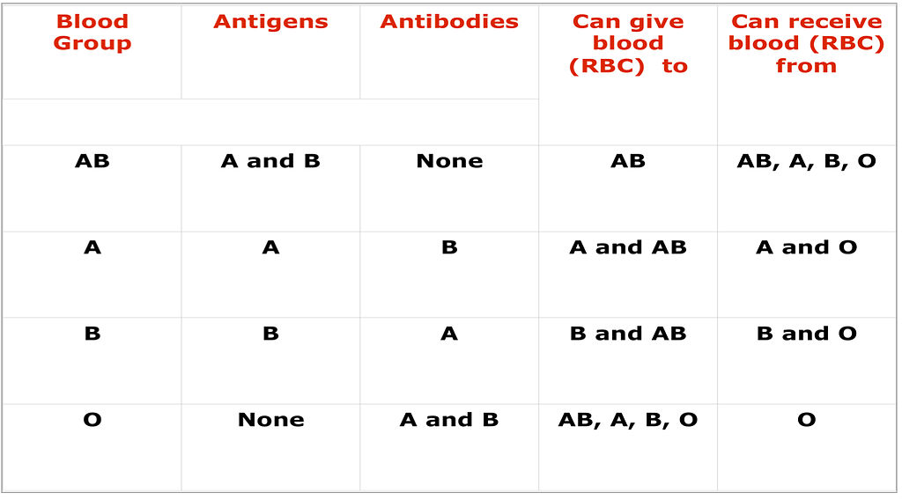
Blood Groups

Slide 9
RH factor
In addition to antigens of ABO system, the red cells of humans also contain an additional antigen, called Rh antigen (or Rh factor).
There are several varieties of Rh antigen—C, D, E, c, d, and e—but the D antigen is the most common, and antigenically, the most potent. Therefore, Rh +ve persons are also called D +ve and Rh –ve are called D –ve.
Persons whose red cells contain this additional antigen are called “Rh positive” ( Rh +) while those who lack this antigen are called “Rh negative” (Rh –).
However, there are no naturally occurring antibodies against Rh (D) antigen.
The Rh (D) antigen is not present in body fluids and tissues, but only on red cells.

Slide 10
Clinical Significance of Rh factor
Although there are no natural anti-Rh antibodies, and they never develop spontaneously, they can be produced only in Rh –ve persons. This can happen in either of 2 ways:

Slide 11
Clinical Significance of Rh factor
In transfusions. When an Rh –ve person receives Rh +ve blood, there is no immediate reaction since there are no antibodies. But during the next few weeks/months, he/she may produce anti-Rh antibodies that will remain in the blood. (Even 0.5 ml of Rh +ve blood is enough to produce immune response). However, if within a few weeks, or even years later, a second Rh +ve blood is injected, the newly donated red cells will be agglutinated and hemolysed, thus resulting in a serious transfusion reaction.

Slide 12
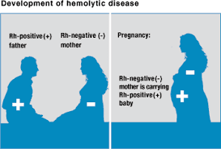
In pregnancy. The most common problem due to Rh incompatibility may arise when an Rh –ve mother (phenotype dd) carries an Rh +ve fetus
Normally, no direct contact occurs between maternal and fetal bloods. However, if a small amount of Rh +ve blood leaks (at the time of delivery) from the fetus through the placenta into the mother’s blood, the mother’s immune system will start to make anti- Rh antibodies.
As a result, some mothers develop high concentration of anti-Rh antibodies during the period following delivery. Therefore, the first-born baby will not be affected.
However, during the second and subsequent pregnancies, the mother’s anti-Rh antibodies cross the placental membrane into the fetus where they cause agglutination and hemolysis. The clinical condition that develops in the fetus is called “hemolytic disease of the newborn (HDN)’ or “erythroblastosis fetalis”

Slide 13
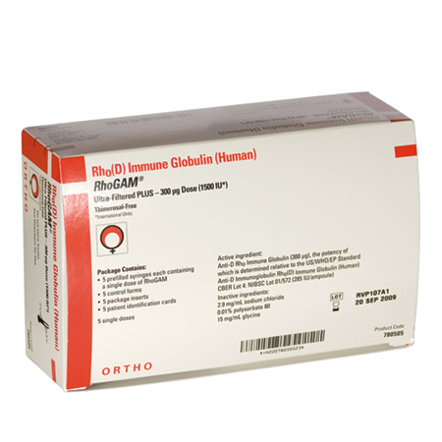
How can hemolytic disease of the newborn be prevented? What is the treatment of severe HDN?
The condition can be prevented by desensitizing all Rh –ve mothers by giving them injections of massive doses of anti-Rh antibodies called Rho(D) immune globulin after every abortion, miscarriage, or delivery.
These antibodies bind to and inactivate the fetal Rh antigens (on fetal red cells) present in maternal circulation. In this way, the Rh antigens from the mother’s blood are cleared (removed) before they have had time to stimulate production of anti-Rh antibodies.

Slide 14
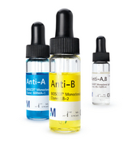
APPARATUS AND MATERIALS
Microscope.
Sterile blood lancet,Sterile cotton/ gauze swabs, Alcohol and Toothpicks.
Clean, dry microscope slides.
Anti-A serum: [contains monoclonal anti-A antibodies (against human).
Anti-B serum: [contains monoclonal anti-B antibodies (against human).
Anti-D (anti-Rh) serum: [Contains monoclonal anti-Rh (D) antibodies (against human).

Slide 15
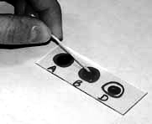
Determining Your Own Blood Type
Clean your finger with alcohol and let dry.
Prick finger with lancet, near the tip but not too close to the nail. You will need three fairly large drops of blood. Prick so that blood flows freely. Try squeezing up from your wrist if blood does not flow after pricking finger.
3. Use one slide for ABO typing and Rh factor. Place three drops of blood on the slide, add the appropriate typing serum, and determine your blood type. Be sure the serum dropper does not touch the drop of blood. Results should be readable in about a minute.
Figure Mixing the anti-serum with the blood sample to determine blood type.

Slide 16
OBSERVATIONS AND RESULTS
It is essential that you should be able to distinguish between “agglutination” and “no agglutination”. The features of each are:
If agglutination occurs, it is usually visible to the naked eye. The hemolysed red cells appear as isolated (separate), dark-red masses (clumps) of different sizes and shapes.
There is brick-red coloring of the serum by the hemoglobin released from ruptured red cells.

Slide 17
What is cross matching?
in transfusion medicine, refers to the test that is performed prior to a blood transfusion in order to determine if the donor's blood is compatible with the blood of an intended recipient.
Cross-matching is also used to determine compatibility between a donor and recipient, in organ transplantation or blood transfusion

Slide 18
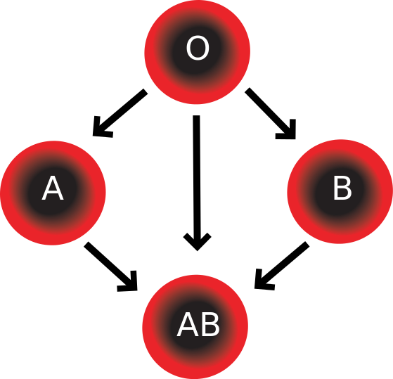
What is meant by the terms universal donor and universal recipient?
Since type O persons do not have either A or B antigens on their red cells, they are called “universal donors” because their blood can, theoretically, be given to all 4 blood types.
Type AB persons are called “universal recipients” because they do not have circulating agglutinins in their plasma and can, therefore, receive blood of any type.

Slide 19
Why does the ABO-incompatibility rarely produce hemolytic disease of the newborn?
The ABO-incompatibility between the mother and fetus rarely causes Hemolytic disease of the newborn (HDN).
The reason is that the anti-A and anti-B (anti-ABO) antibodies belong to IgM type of gamma globulins (big size) that do not cross the placenta.

Slide 20
Notes:
To provide maximum benefit from each blood donation and to extend shelf-life, blood banks fractionate some whole blood into several products. The most common of these products are packed RBCs, plasma, and platelets.
With regard to transfusions of packed red blood cells, individuals with type O Rh D negative blood are often called universal donors, and those with type AB Rh D positive blood are called universal recipients.
With regard to transfusions of plasma, this situation is reversed. Type O plasma, containing both anti-A and anti-B antibodies, can only be given to O recipients. The antibodies will attack the antigens on any other blood type. Conversely, AB plasma can be given to patients of any ABO blood group due to not containing any anti-A or anti-B antibodies.

Slide 21
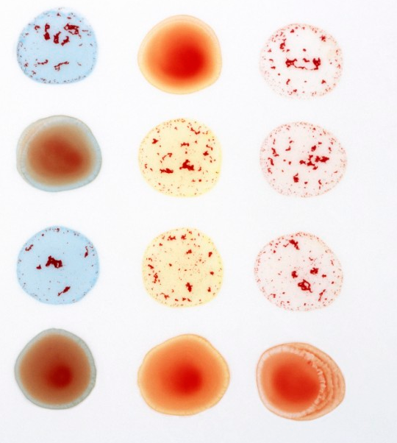
Anti-A Anti-B Anti-D
1
2
3
4

Slide 22
Thank you

